Slide 1
The cell membrane
4

Slide 2
- A cell cannot survive if it is completely isolated from its environment. The cell membrane (also known as the plasma membrane or cytoplasmic membrane) is a biological membrane that separates the interior of all cells from the outside environment.
- Before the emergence of electron microscopy in the 1950s, scientists did not know the structure of a cell membrane or what its components were; biologists and other researchers used indirect evidence to identify membranes before they could actually be visualized.

Slide 3
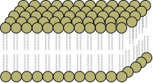
Historical Models of Plasma Membrane
1. Lipid and Lipid Bilayer Model:
In 1902, Overton observed that substances soluble in lipid could selectively pass through the membranes. On this basis he stated that plasma membrane is composed of a thin layer of lipid.
Subsequently, Gorter and Grendel in 1926 observed that the extracted from erythrocyte membranes was twice the amount expected if a single layer was present throughout the surface area of these cells. On this basis they stated that plasma membrane is made up of double layer of lipid molecules.

Slide 4
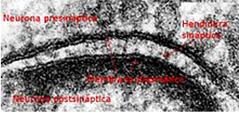
2. Unit Membrane Model (Protein-Lipid Bilayer-Protein):
In 1935, Davson and Danielli proposed that biological membranes are made up of lipid bi-layers that are coated on both sides with thin sheets of protein. With the availability of electron microscope in 1950 the structure of plasma membrane could be studied. David Robertson used this method to propose the unit membrane model. Basically, he suggested that all cellular membranes share a similar underlying structure, the unit membrane. Using heavy metal staining, Robertson's proposal also seemed to agree instantaneously with the Davson-Danielli model. According to the trilaminar pattern of the cellular membrane viewed by Robertson, he suggested that the membranes consist of a lipid bi-layer covered on both surfaces with thin sheets of proteins.

Slide 5
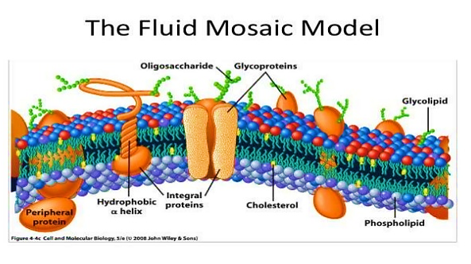
3. Fluid Mosaic Model:
In 1972, S. Jonathan Singer and Garth Nicolson developed new ideas for membrane structure. Their proposal was the fluid mosaic model, which is the dominant model now. It has two key features : a mosaic of proteins embedded in the membrane, and the membrane being a fluid bi-layer of lipids.

Slide 6
The characteristics of cell membrane
The cell membrane is a fluid mosaic of proteins moving in a phospholipid bilayer.
The cell membrane functions like a gate, controlling which molecules can enter and leave the cell.
The membrane consists of proteins, lipids and carbohydrates, where lipids beaning as a structure, and proteins are connected or immersed in fat and interact with each other and with the lipids, while retaining it capability to movement within the lipids.

Slide 7
4.The head of phospholipids molecule is charged and so polar; the tails are not charged and so are non-polar. Thus, the two ends of this molecule have different properties in water. The head is hydrophilic and so their position will going to be upper and lower surfaces of the membrane as close as possible to water molecules. The non- polar tails are hydrophobic and so will tend to direction within the membrane and correspond to each other away from water.

Slide 8
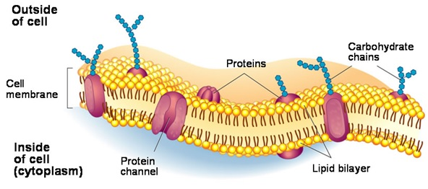
5.This causes the phospholipids of the cell membrane to form two layers, known as a phospholipid bilayer.

Slide 9
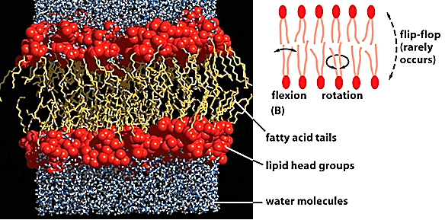
6. Cells are bathed in an aqueous environment and since the inside of a cell is also aqueous, water molecules surround both sides of the cell membrane.

Slide 10
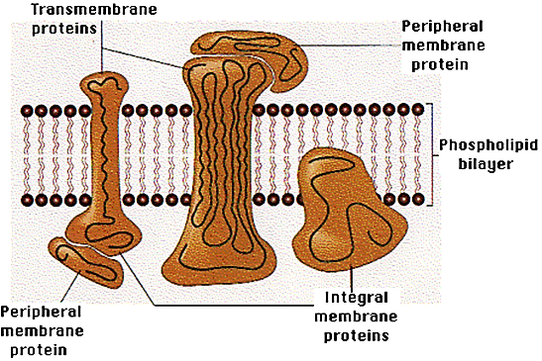
7. Membrane Proteins
Theirs two types of membrane proteins:
– Integral protein
• Penetrate the hydrophobic interior; can stick out of the surface
• Integral proteins that extent the
membrane are called transmembrane proteins.
– Peripheral protein : Stick to the surface
of the membrane .

Slide 11
8. Integral proteins types are:
Channel proteins: They have a channel that allows a substance to simply move across the membrane.
Carrier proteins: They combine with a substance and help it move across the membrane.
Cell recognition proteins: These proteins help the body recognize when it is being invaded by pathogens so that an immune reaction can occur.
Receptor proteins: have a shape that allows a specific molecule to bind to it.
Enzymatic proteins: carry out metabolic reactions directly.

Slide 12
10. Carbohydrates: it connected with Peripheral proteins and distinct parts of Integral proteins on the upper surface of the membrane, made up what is known Glycocalyx which have important functions in the cell life :
a. Molecular Recognition.
b. Filtration .
c. Enzymatic function.
d. Microenvironment .

